Slide 1
Business plan of starting Japanese restaurant in New York
By Carol
Apr 2021

Slide 2
BUSINESS PROBLEM
Global economic is badly harmed by COVID-19
The wide adoption of vaccination is a sign to revoke our business especially tourism and entertainment
To big city like New York, let’s plan
What restaurant has more potential to grow?
Would Japanese restaurant have a competitive edge? When more people are looking for healthy and balanced diets
Which location is more potential?

Slide 3
METHODOLOGY
Basic information (neighborhoods and boroughs, latitudes, and longitudes) about New York City is collected from https://cocl.us/new_york_dataset
FourSquare API provides data about existing Japanese restaurant location and quality
From these two sources, comment the existing and potential growth of different areas
By sorting and visualization, recommend the best location of starting a new Japanese restaurant

Slide 4
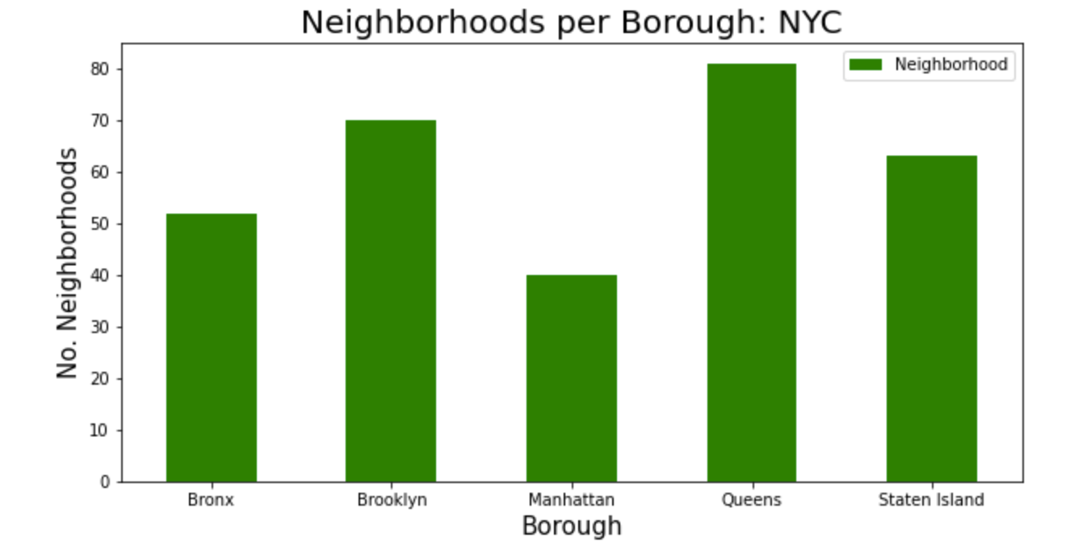
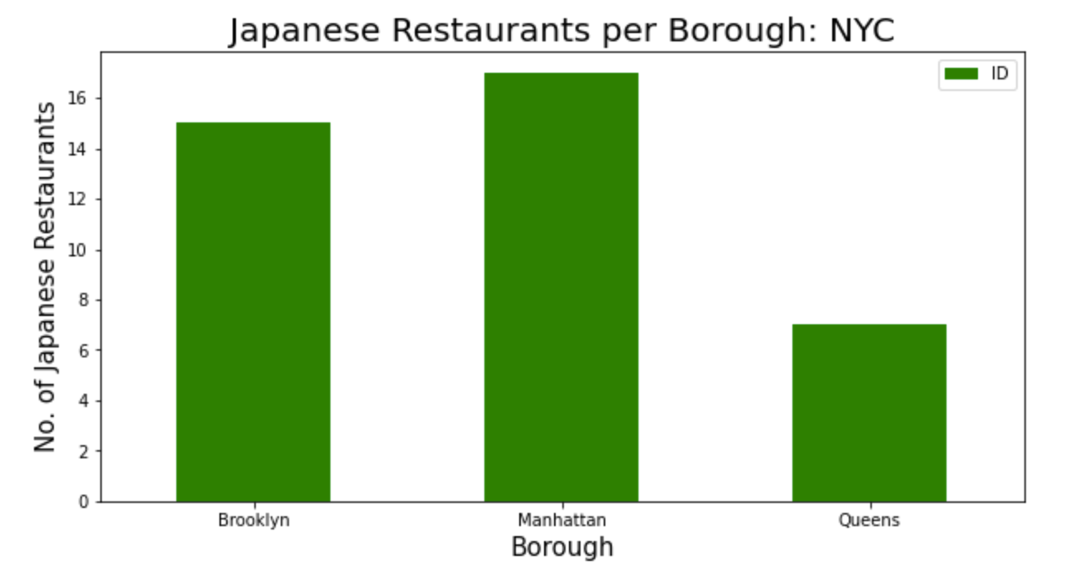
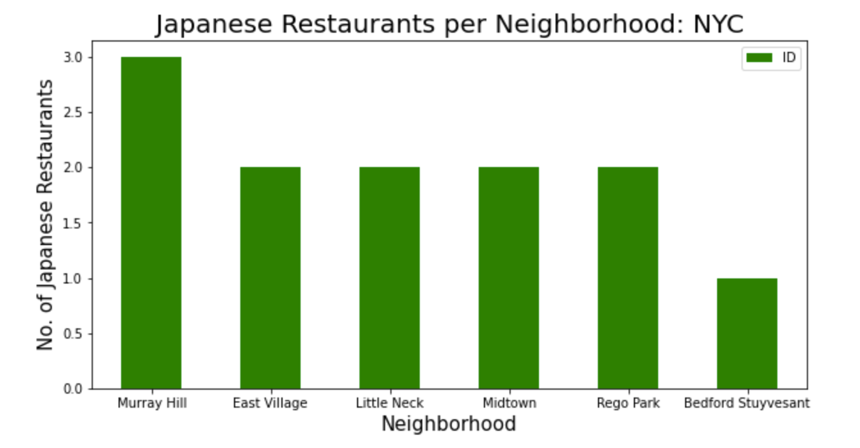
KEY FINDINGS
In term of neighborhoods, Queens has the most (80) whereas Manhattan has the least, only half of Queens (40)
39 Japanese restaurants are running currently, most are located in Manhattan (By borough); Murray Hill (By neighborhoods)

Slide 5
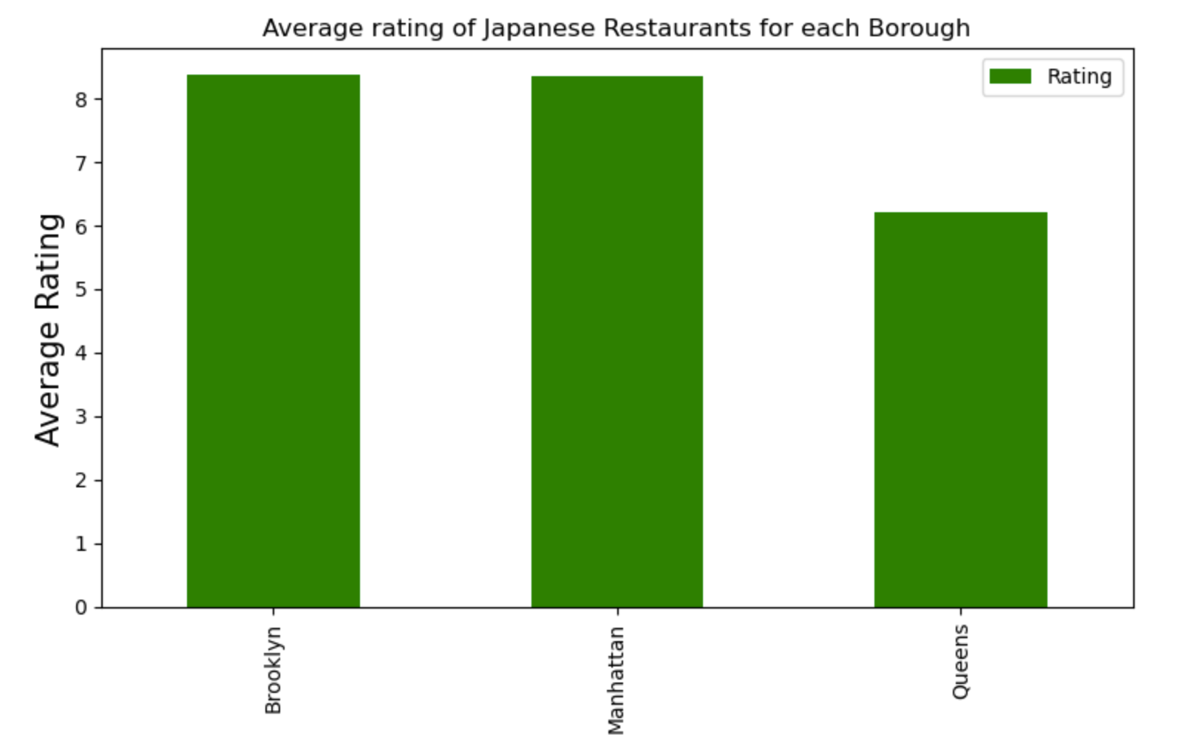
KEY FINDINGS
The average score of existing Japanese restaurant is
57 likes
8.2 rating
19 tips
The best performers are always in Brooklyn
899 likes for Samurai Mama @ Brooklyn (North Side)
247 tips for Samurai Mama @ Brooklyn (North Side)
9.3 rating for Kura @ Manhattan (East Village)

Slide 6
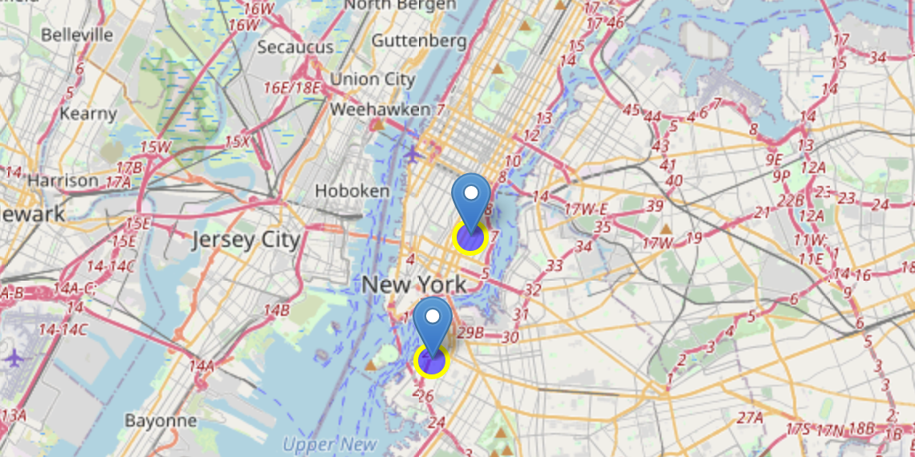
KEY FINDINGS
We only look at those having rating >=9.0 as we plan to serve premium class
Brooklyn (Cobble Hill)
Manhattan (East Village)

Slide 7
CONCLUSION
Brooklyn is recommended as
Getting multiple neighborhoods with average ratings exceeding 8.0
Having less amount of Japanese restaurants than Manhattan, making competition easier
Renting is cheaper than in Manhattan

